Slide 1
April 7th & 8th Notes and PowerPoint Slides
Honors Biology

Slide 9
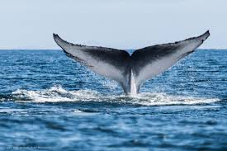
Manatees and Whales have Similar Shaped Flukes (back flippers). They are completely different types of mammals.

Slide 12
Propose a mechanism that would allow the different species of flowers in this photo to distinguish between pollen from their own species and alien types of pollen?

Slide 15
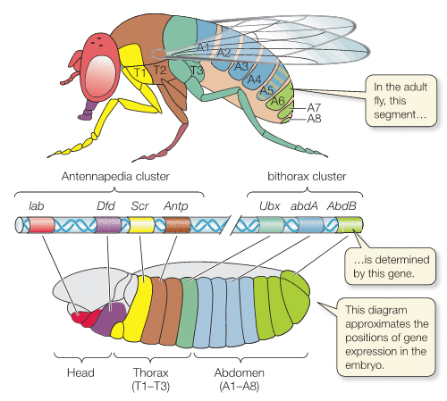

Slide 16
