Slide 1
April 6th Notes
Honors Biology

Slide 2
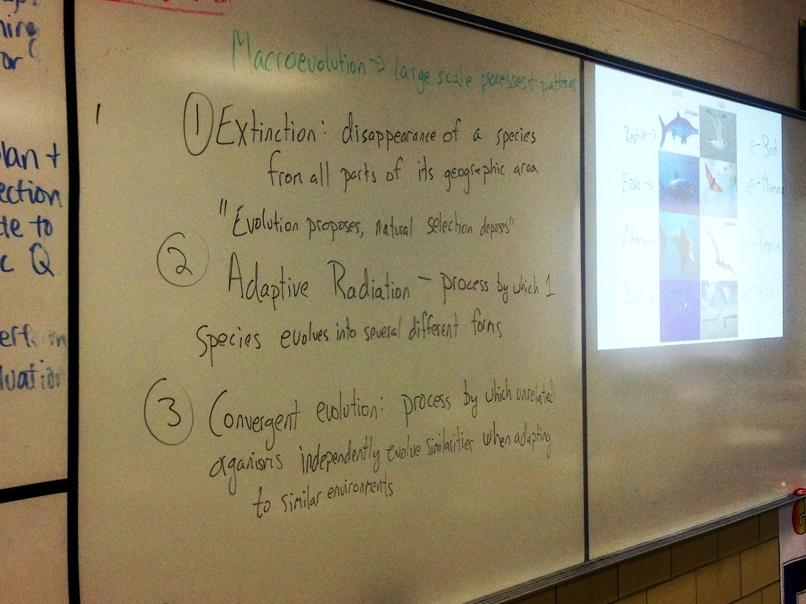

Slide 3
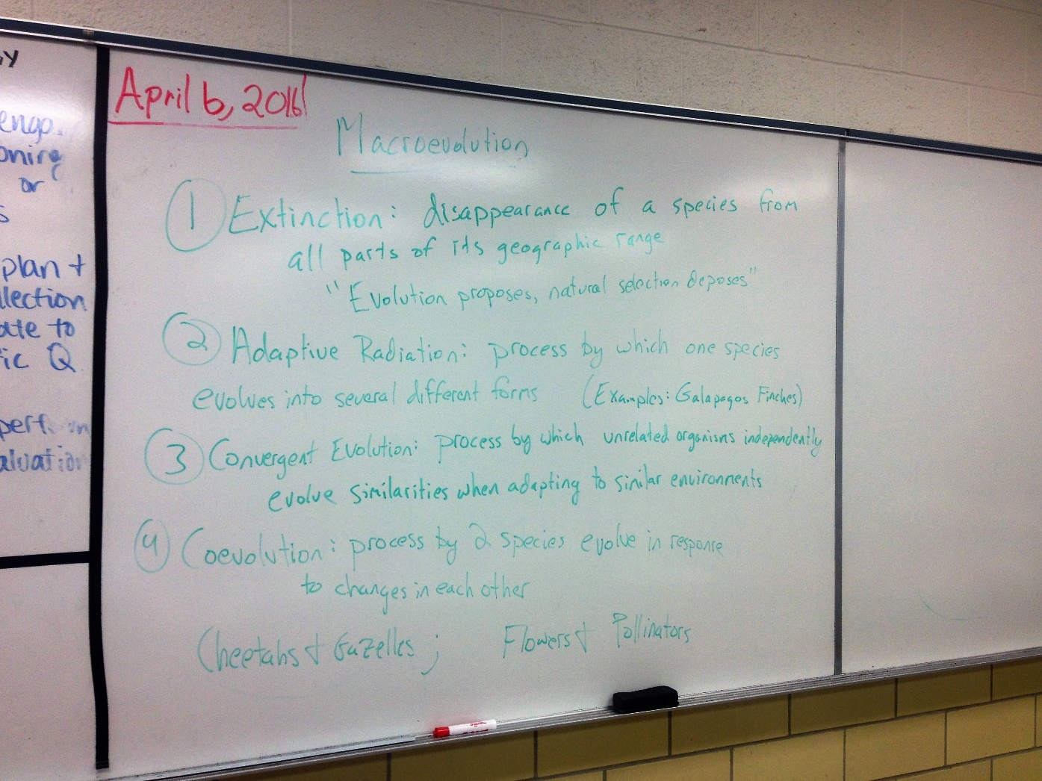

Slide 4
