Slide 1
Evolution Notes
March 14 - 17

Slide 2
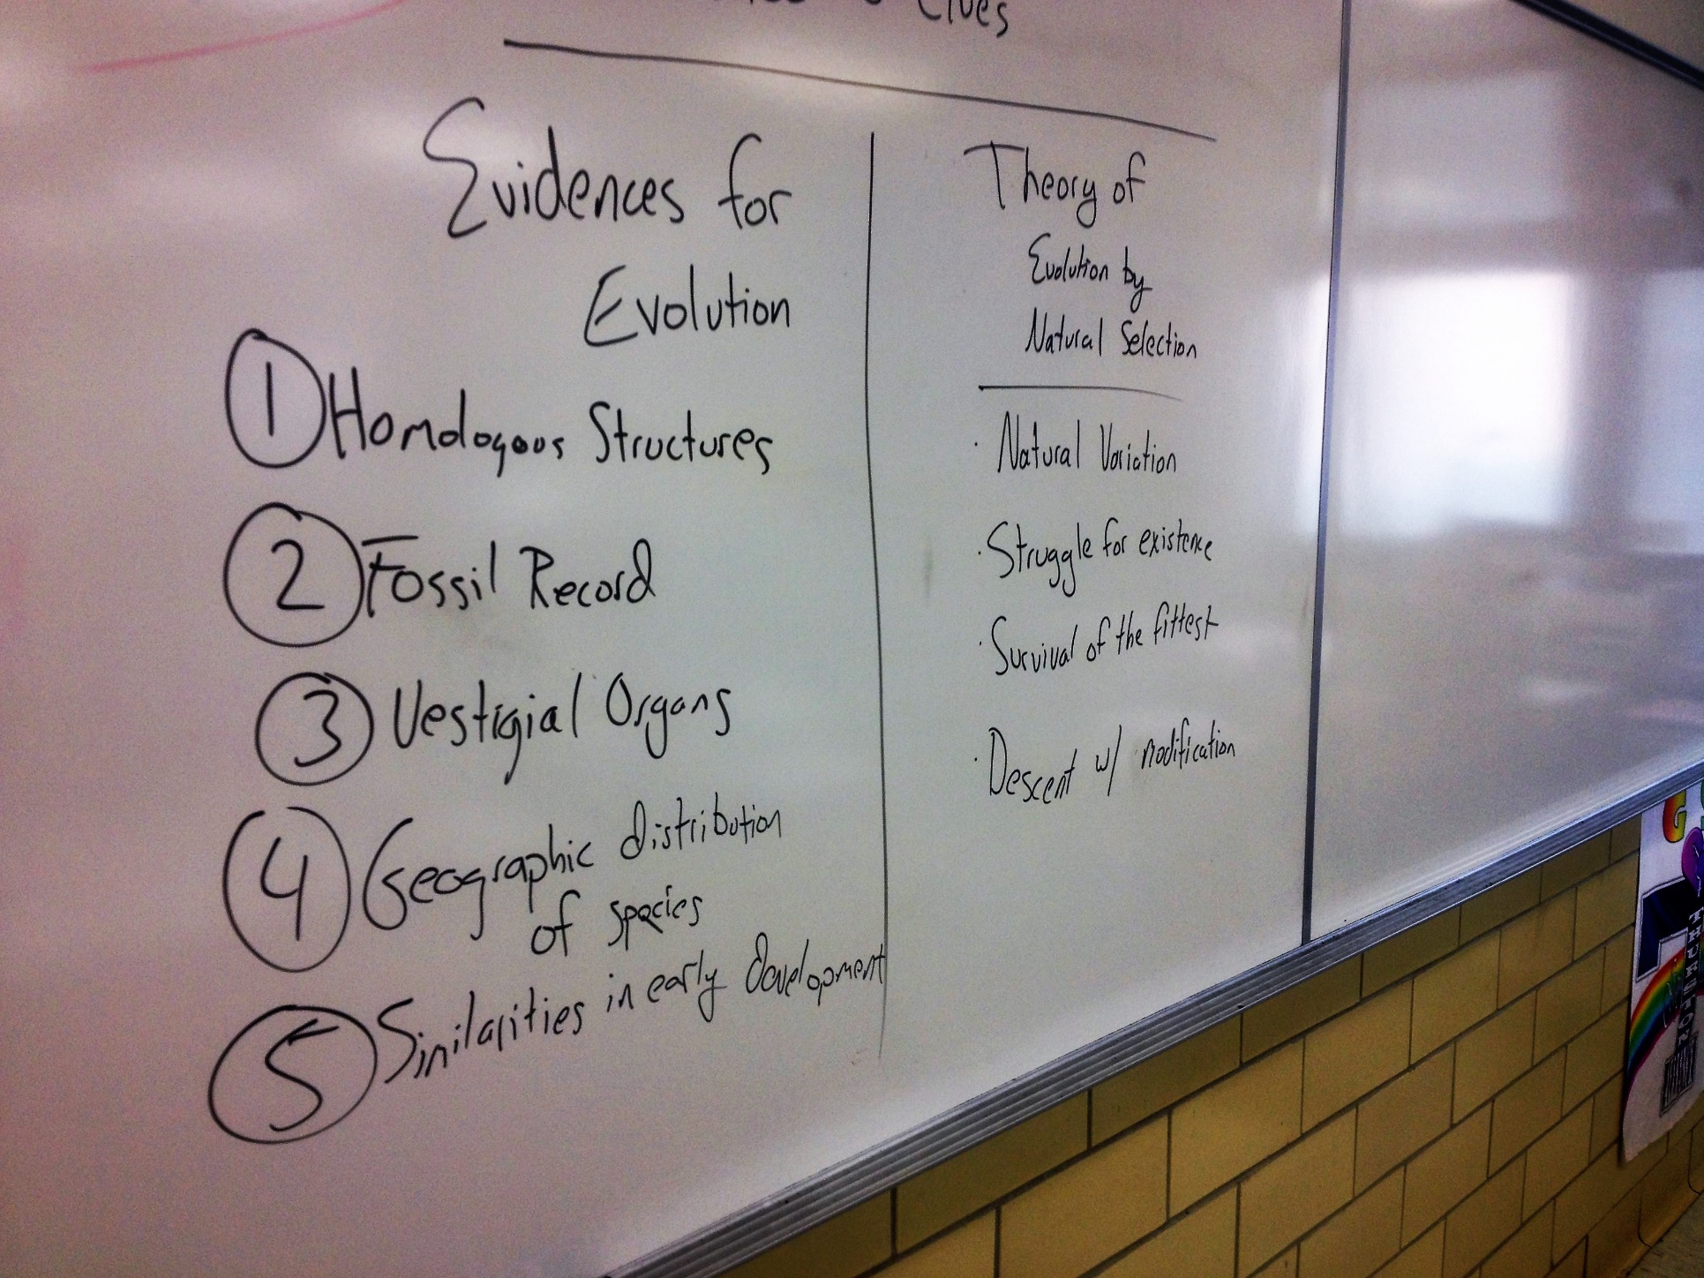

Slide 3
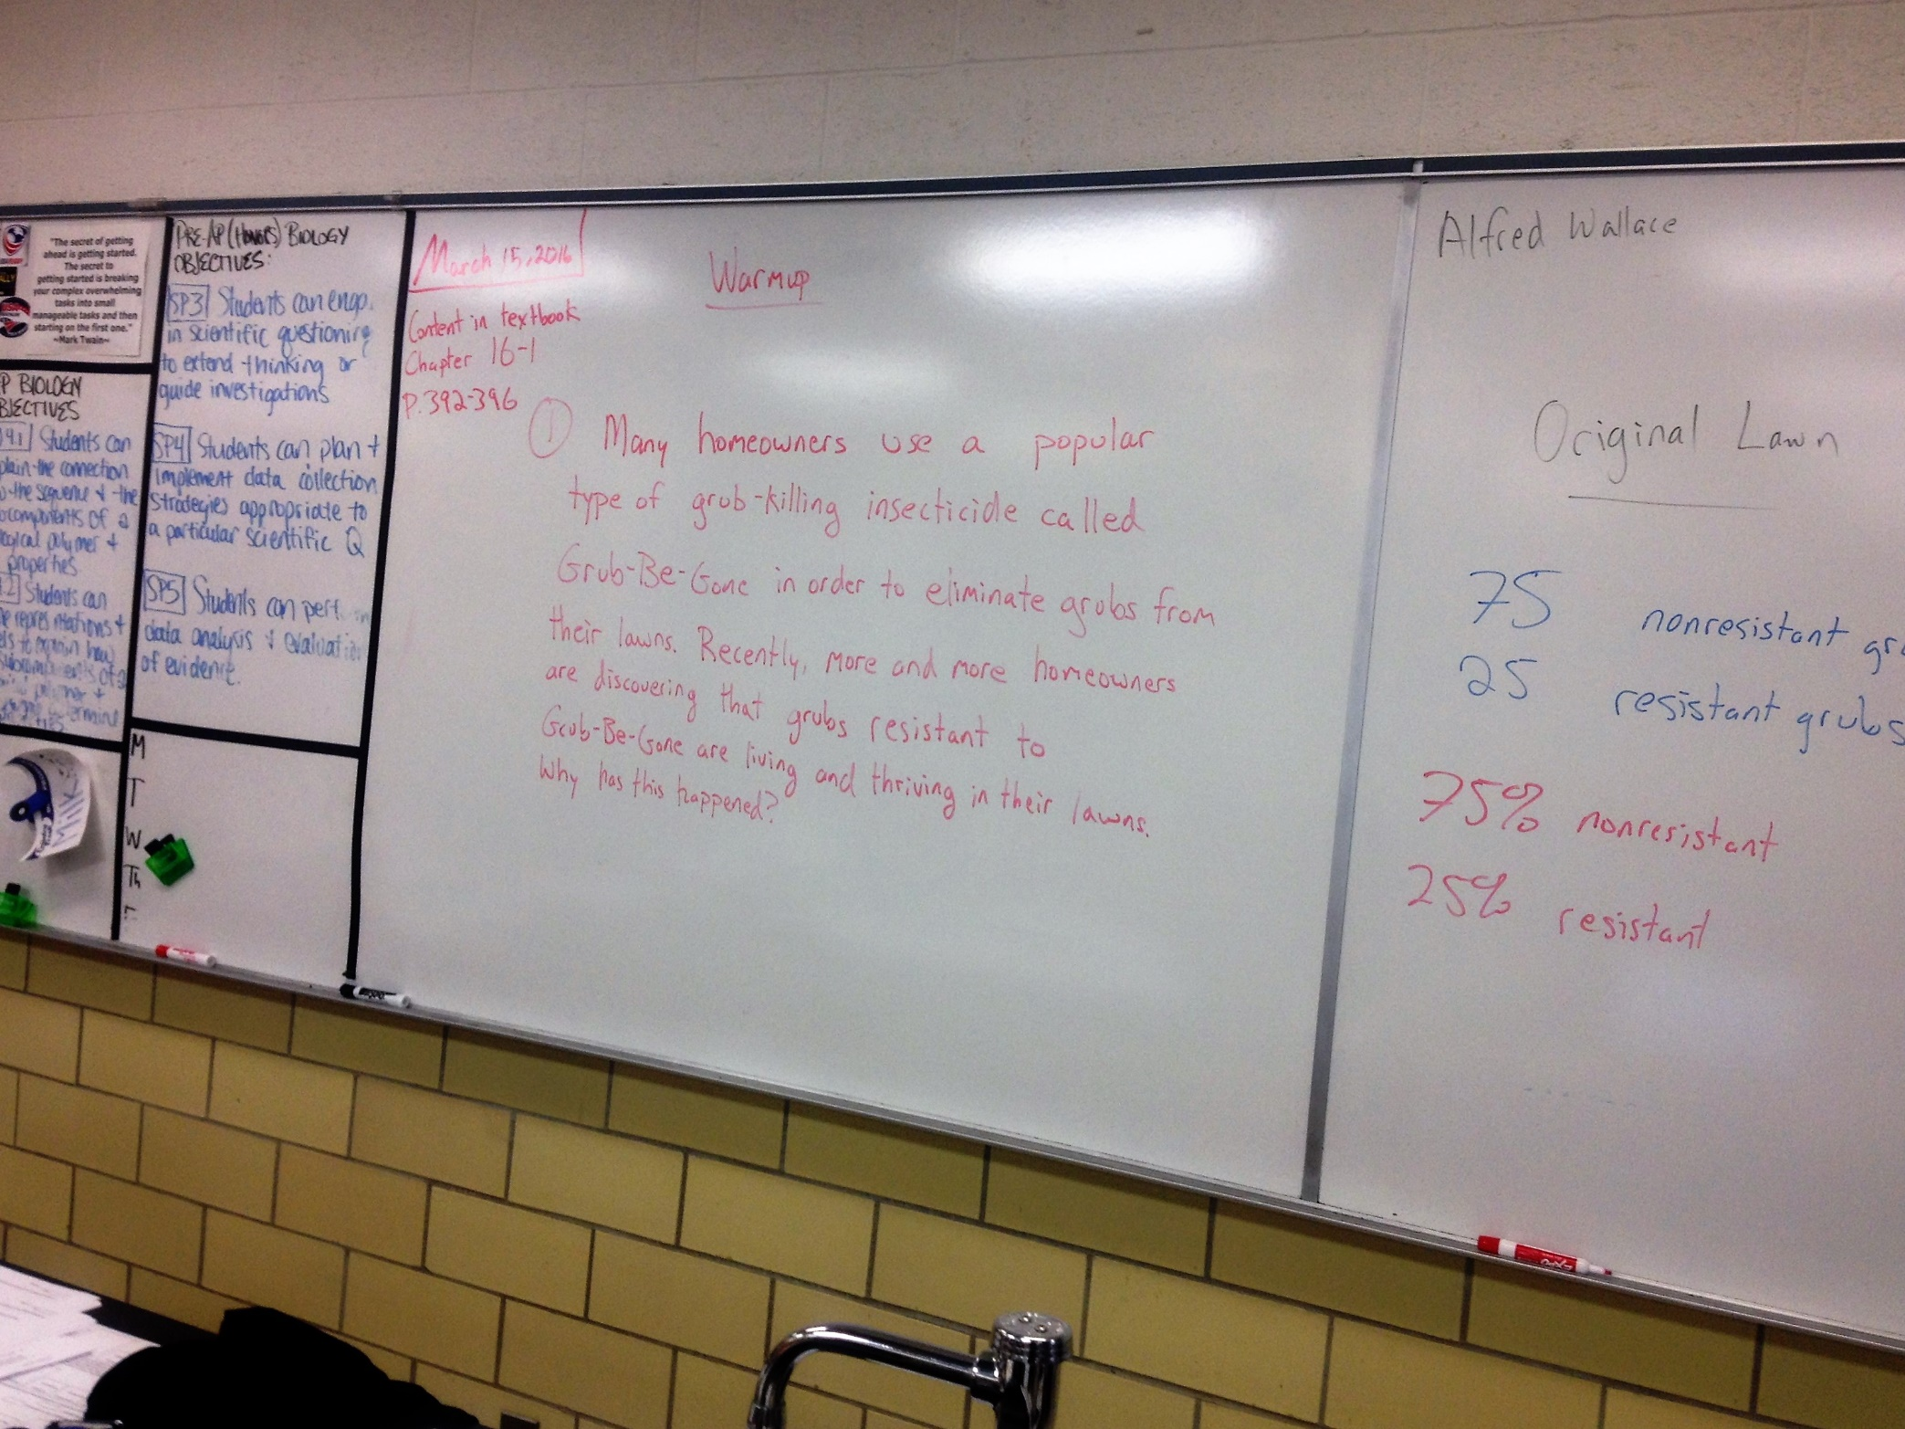

Slide 4
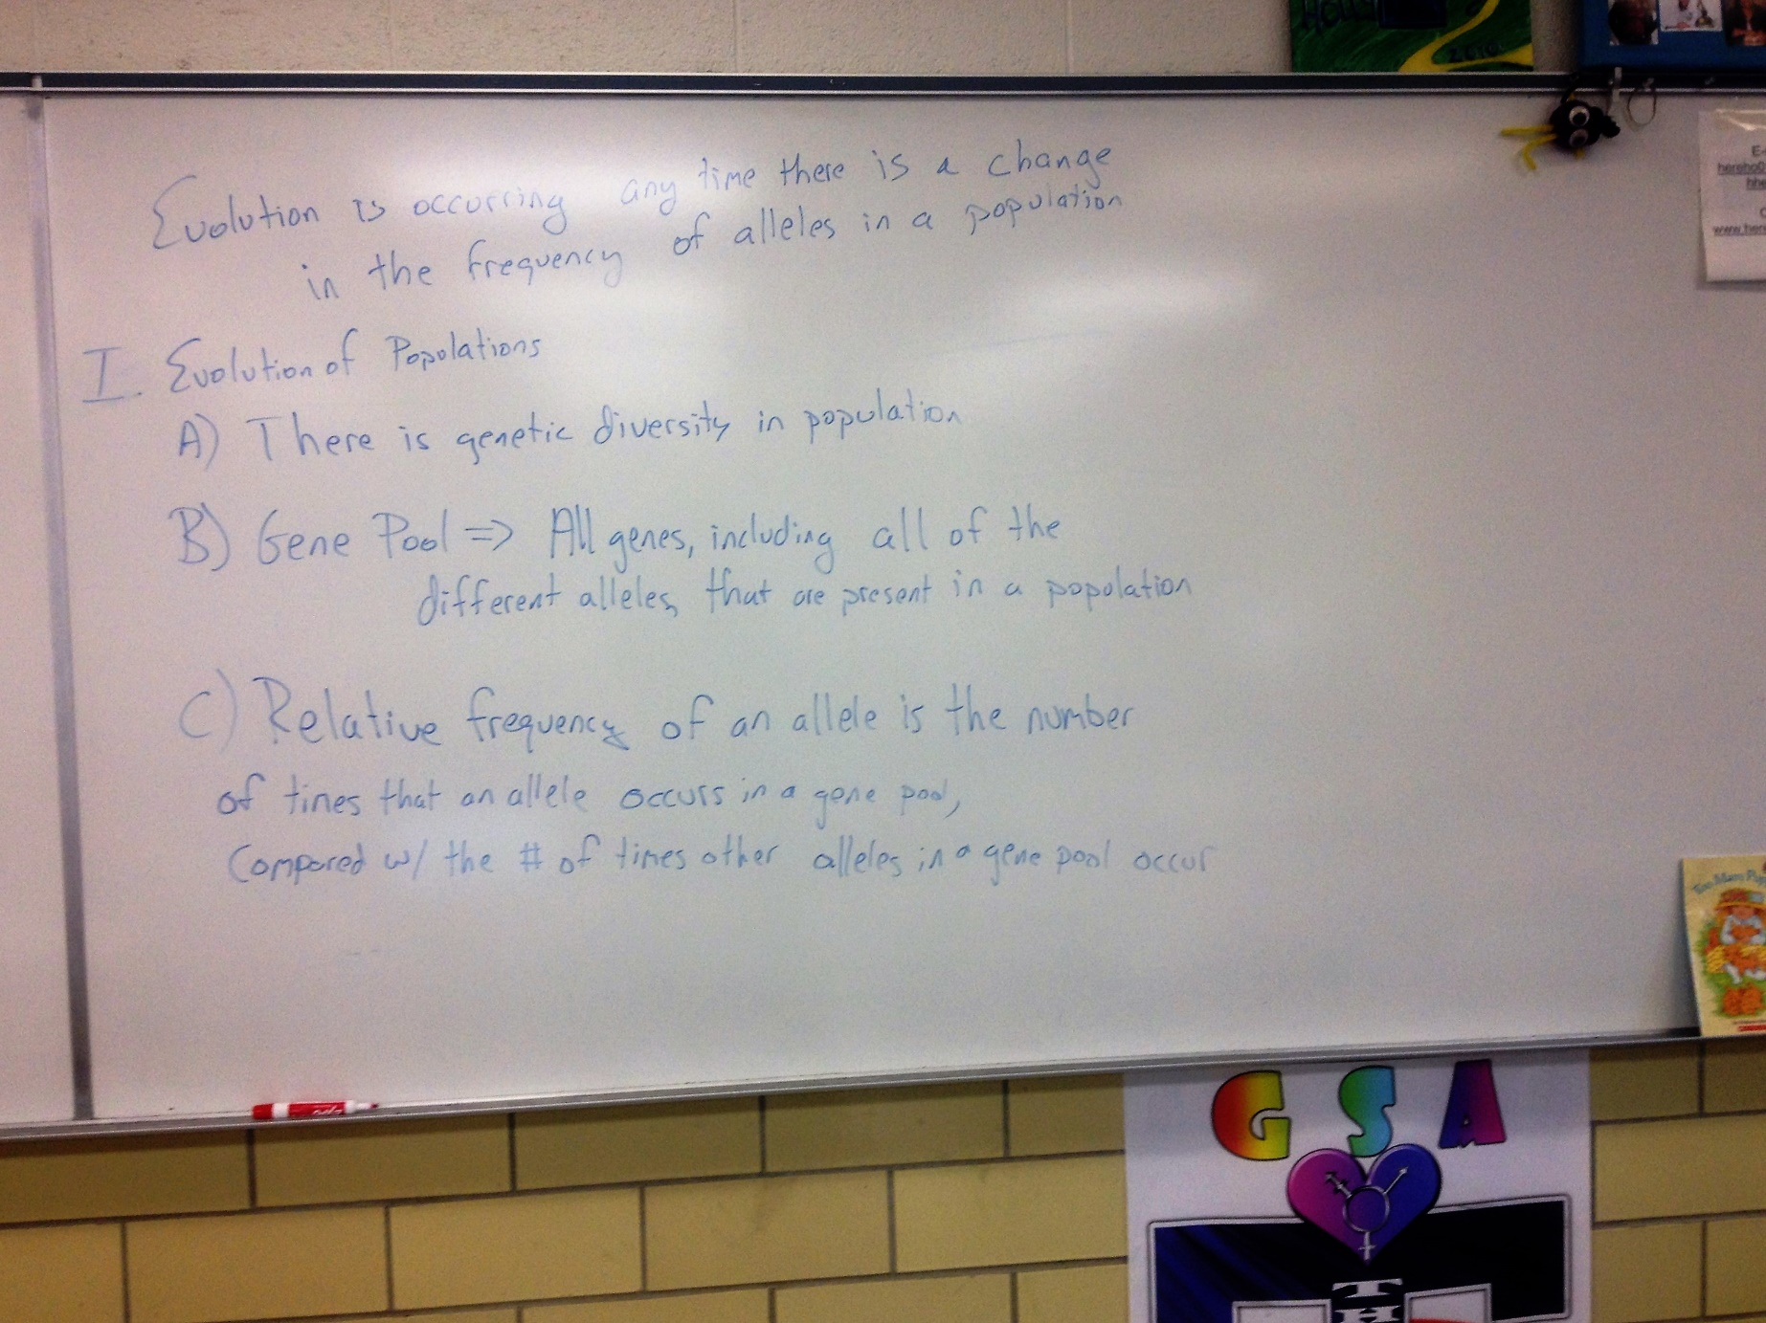

Slide 5
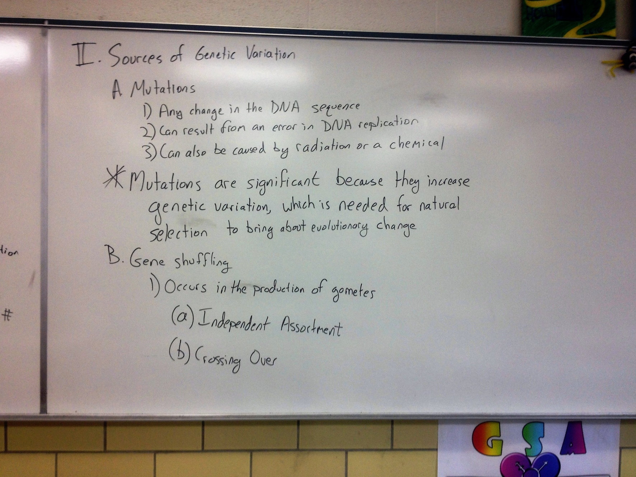

Slide 6
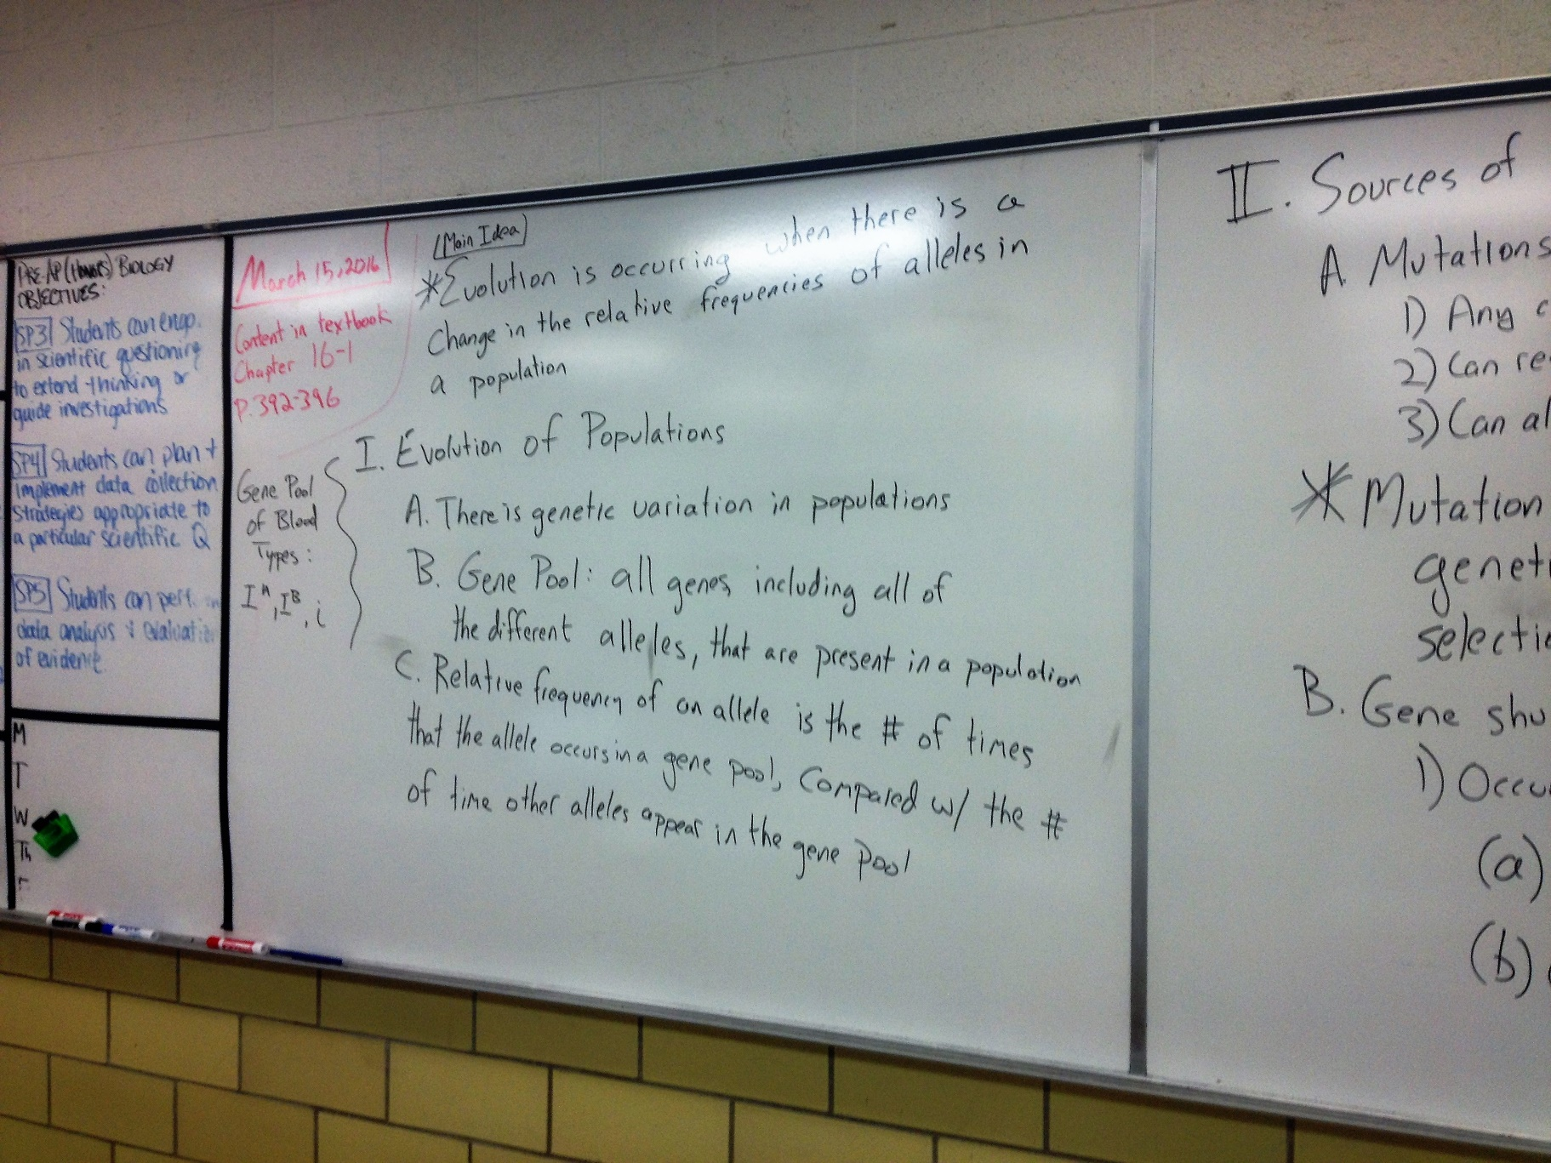

Slide 7
Single-Gene and Polygenic Traits
The number of phenotypes produced for a given trait depends on how many genes control the trait
Single-gene traits have two alleles (e.g. the gene that codes for widow’s peak)
  Represented with a bar graph
Polygenic traits are traits controlled by two or more alleles
  Represented by a bell-like graph

Slide 8
Warmup Questions (3/16)
For blood types, how many ABO genotypes are possible?
What are two sources of heritable variation? Explain how these sources create variation.
How are allele frequencies related to gene pools?

Slide 9
Notes about Evolution
Natural selection on single-gene traits can lead to changes in allele frequencies and thus to evolution
Evolutionary fitness = an organism’s success in passing genes to the next generation

Slide 10
Genetic Equilibrium
Defined: allele frequencies remain constant
Five Conditions required for equilibrium
  Random mating (mates don’t choose each other)
  Population must be very large
  There can be no movement into or out of the population
  No Mutations
  No Natural Selection

Slide 11
Single-Gene and Polygenic Traits
The # of phenotypes produced for a given trait depends on how many genes control the trait
Single-gene traits have 2 alleles
Polygenic traits are traits controlled by 2 or more alleles
  Represented by a bell-like graph

Slide 12
Natural Selection on Polygenic Traits
Directional Selection – when individuals at 1 end of the curve have higher fitness than individuals in the middle or at the other end
  A population of seed-eating birds experiences a shortage of small seeds. This results in an increase in the average beak size of birds over time
Stabilizing Selection – when individuals near the center of the curve have higher fitness than individuals at either end of the curve
  Example: humans tend to be born between 5.5 lbs and 10 lbs.
Disruptive selection – when individuals at the upper and lower ends of the curve have higher fitness than individuals near the middle
  Change in seed size from medium to small and large results in birds with small beaks and birds with large beaks becoming most successful and prevalent in a population

