Slide 1
Feb. 11 Notes
Steps of DNA Replication

Slide 2
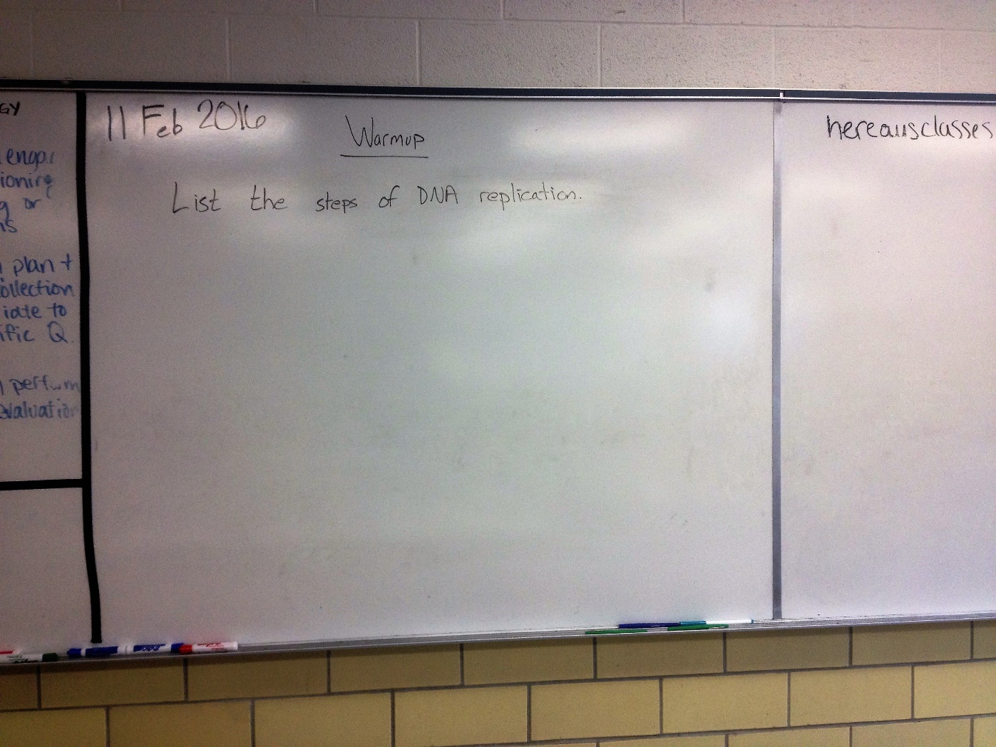

Slide 3
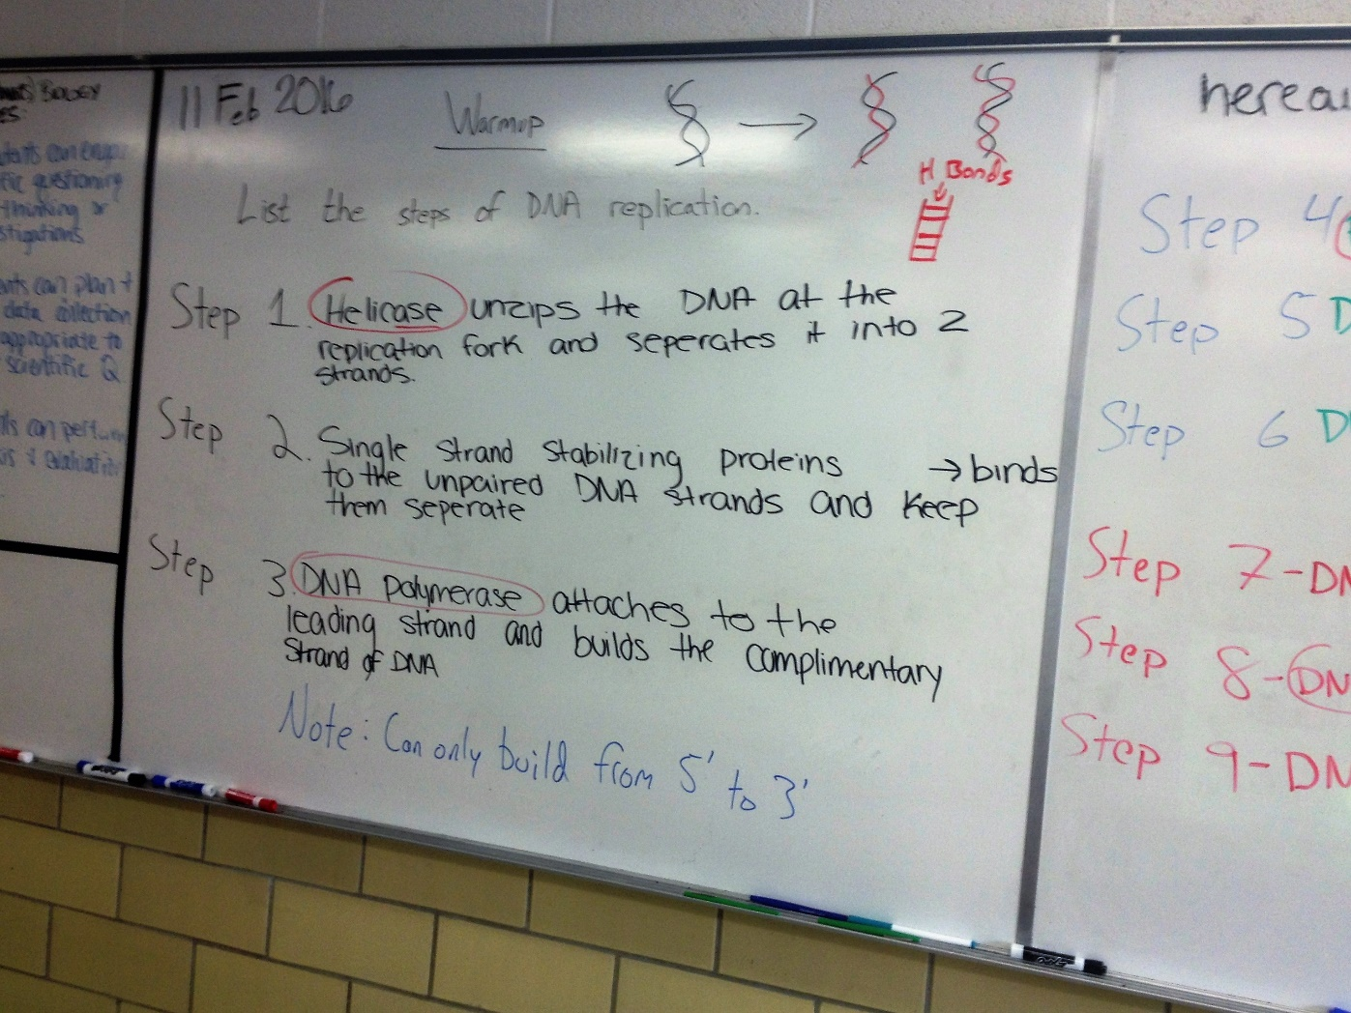

Slide 4
