Slide 1
Introduction to DNA
February 9th, 2016

Slide 2
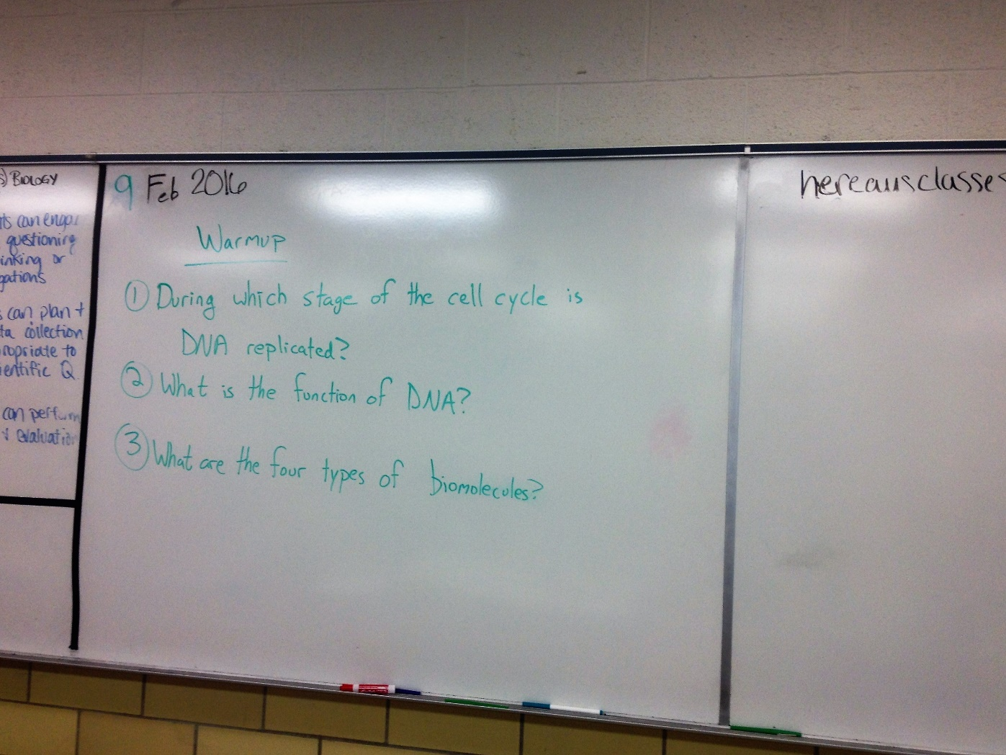

Slide 3
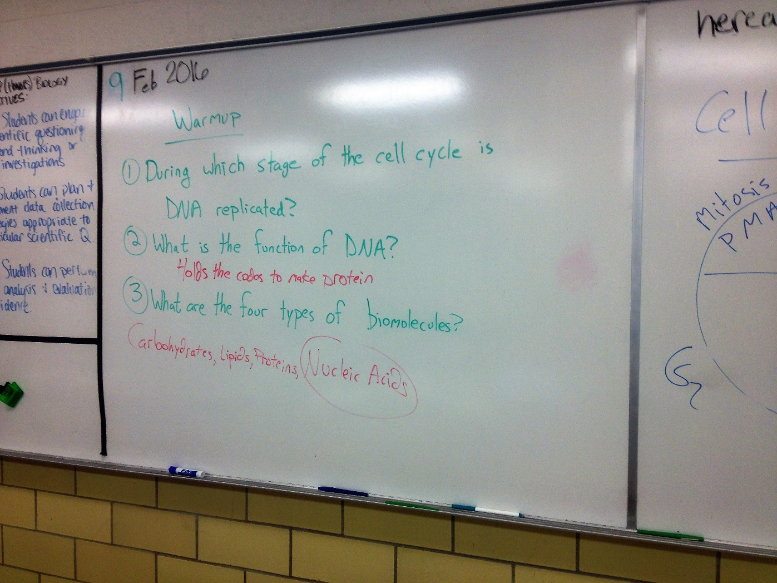

Slide 4
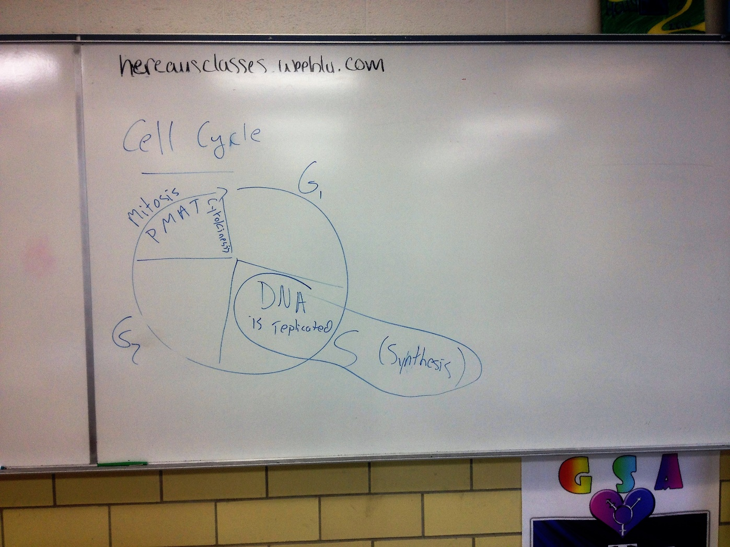

Slide 5
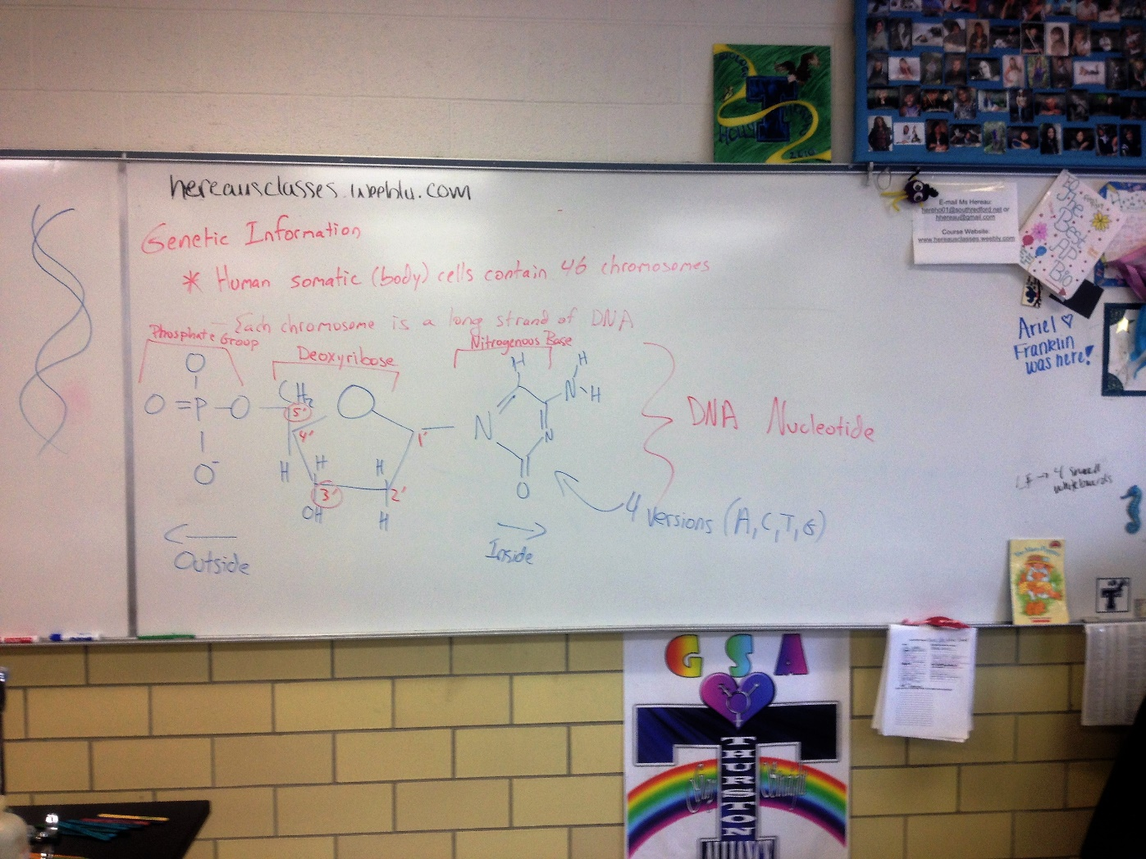

Slide 6
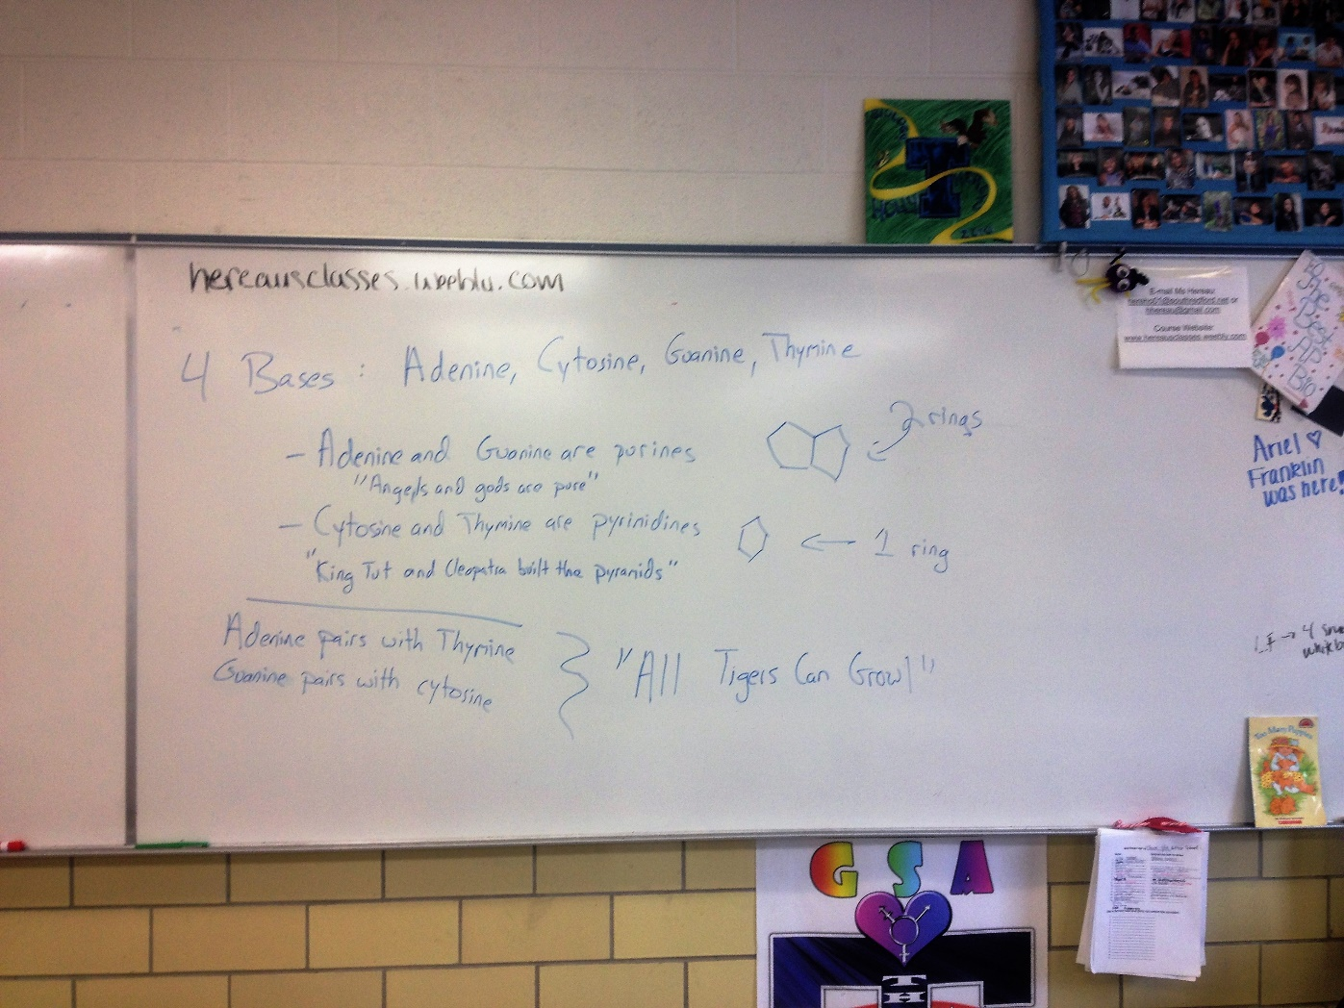

Slide 7
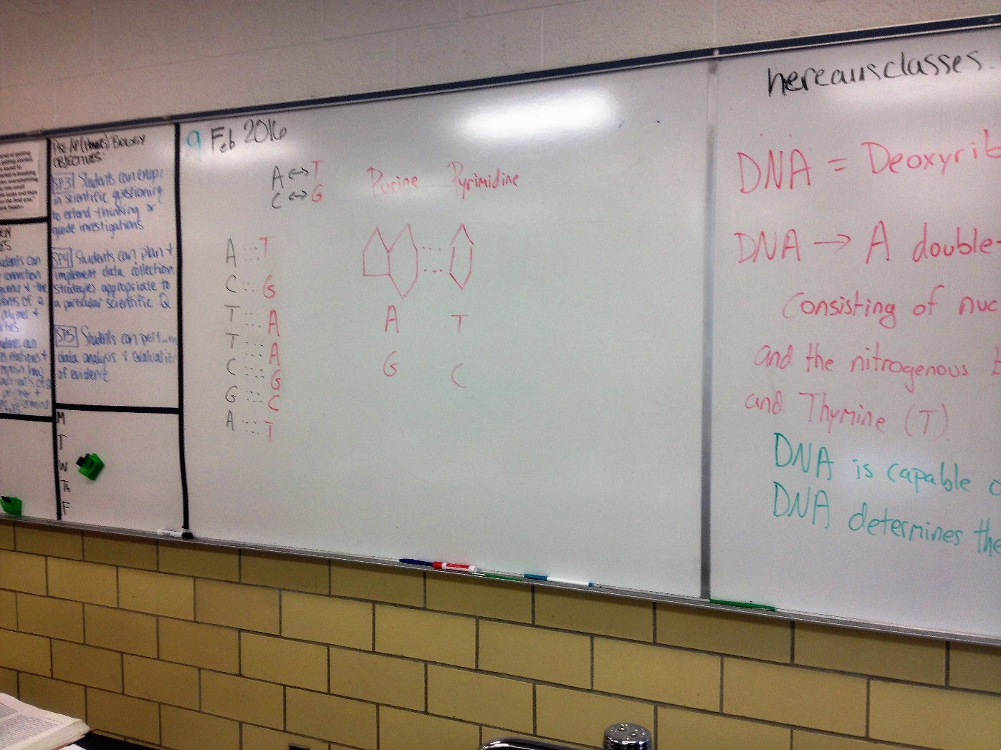

Slide 8
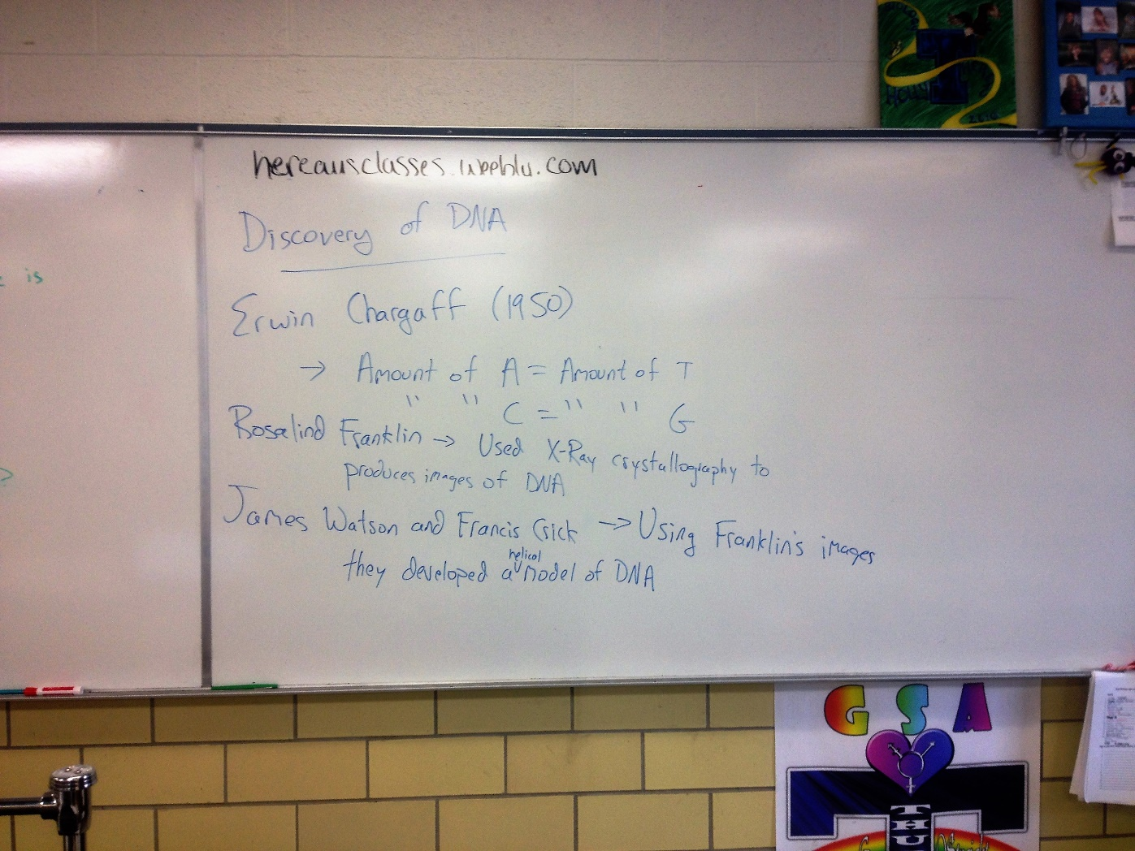

Slide 9
Genetic Information
*46 chromosomes in each of your somatic cells
-Each chromosome is a long strand of DNA
*DNA = Deoxyribonucleic Acid
“A double-stranded, helical nucleic acid molecule, consisting of nucleotide monomers with a deoxyribose sugar and the nitrogenous bases adenine (A), cytosine (C), guanine (G), and thymine (T); capable of being replicated and determining the inherited structure of a cell’s proteins”
Monomer = a subunit or building block of a polymer
Polymer = long molecule consisting of many similar or identical monomers

Slide 10
Discovery of DNA
Frederick Griffith – In 1928, Griffith discovered a phenomenon called transformation, defined as a change in genotype and phenotype due to the assimilation of external DNA by a cell
Oswald Avery – In 1944, Avery discovered that the transforming agent was DNA

Slide 11
Discovery of DNA
Erwin Chargaff – In 1950, Chargaff discovered that DNA’s four bases appeared in specific ratios in DNA.
  Chargaff’s Rules: Amount of A = Amount of T, ‘’ “ C = “ “ G
Rosalind Franklin – Advanced skill with x-ray diffraction helped produced images of DNA. These images proved that DNA was a double helix
James Watson and Francis Crick – Using Franklin’s images, they discovered the double helix shape of DNA

Slide 12
Structure of DNA
DNA nucleotide consists of: nitrogenous base, the sugar deoxyribose, and a phosphate group
Double Helix (twisted staircase)
Double Helix: The form of native DNA, referring to its two adjacent antiparallel polynucleotide strands wound around an imaginary axis into a spiral shape
4 Bases: Adenine (A), Cytosine (C), Guanine (G), Thymine (T)
  Adenine and Guanine are purines (2 rings)
  Cytosine and Thymine are pyrimidines (1 rings)
  A – T, C—G
  “All Tigers Can Growl”

