Slide 1
Evolution Notes
March 10th, 2016

Slide 2
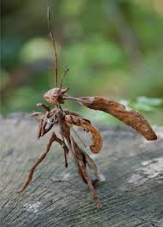
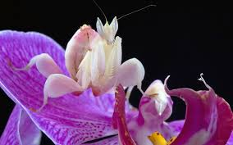
Examples of Natural Variation

Slide 3
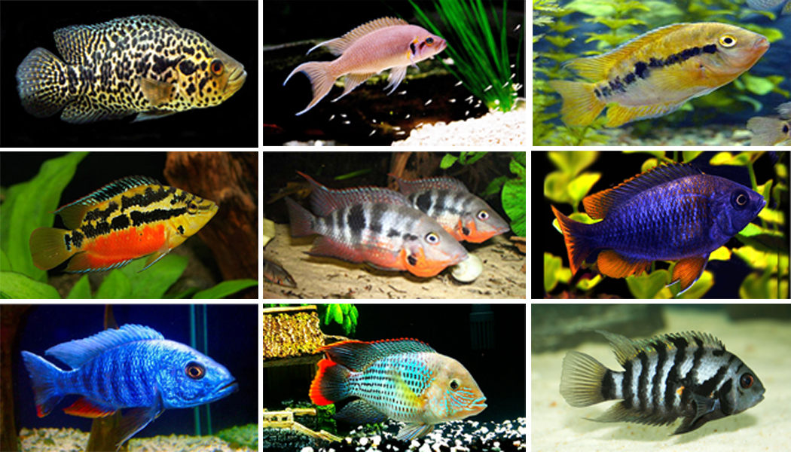
Cichlids

Slide 4
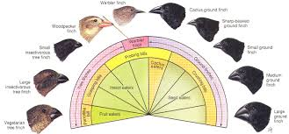

Slide 5
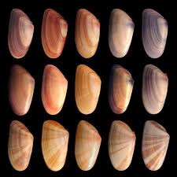

Slide 6
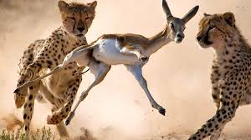
Struggle for Existence

Slide 7
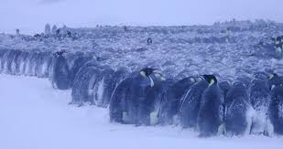
Emperor Penguins

Slide 8
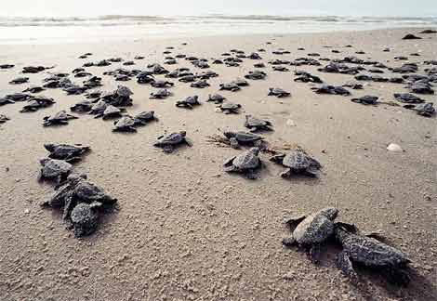
Sea Turtle Hatchlings

Slide 9
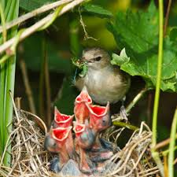
Baby Birds

Slide 10
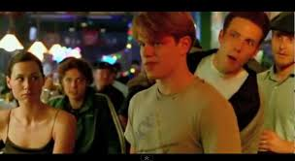

College Admissions and Dates

Slide 11
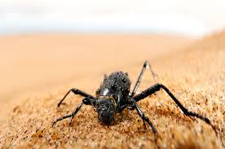
Fitness and Adaptation

Slide 12
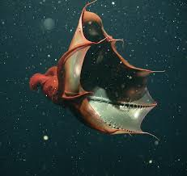
Vampire Squid

Slide 13
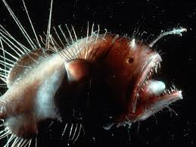
Anglerfish – Lives in the Deep Ocean

Slide 14
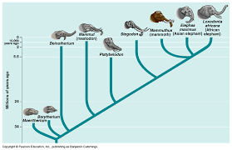
Descent with Modification

Slide 15
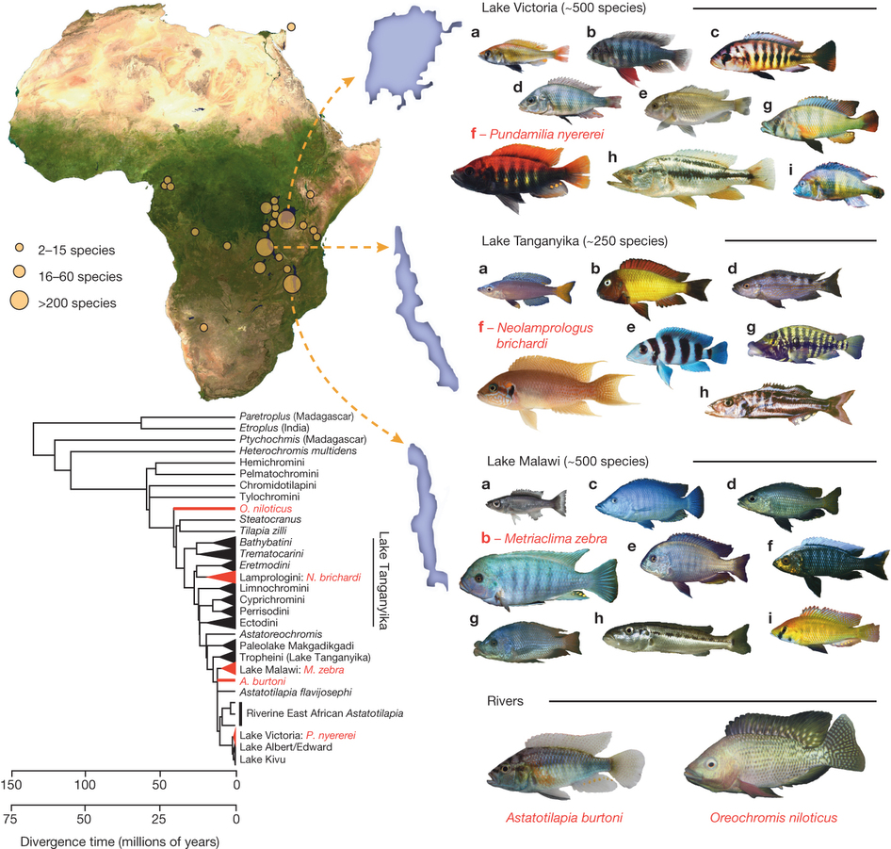

Slide 16
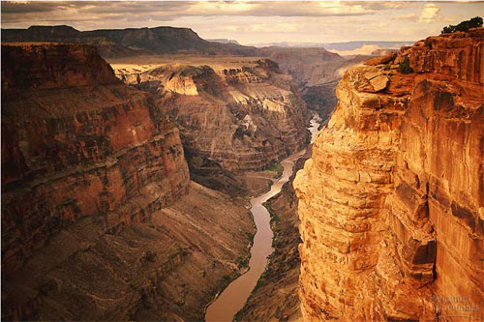
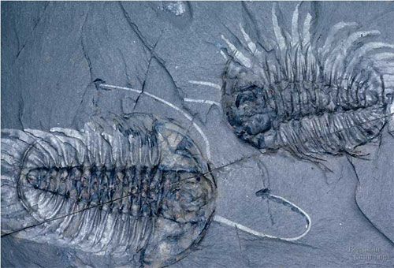
1. Evidence of Evolution: Fossil record
Layers of rock contain fossils
  new layers cover older ones
    creates a record over time
  fossils show a series of organisms have lived on Earth
    over a long period of time

Slide 17
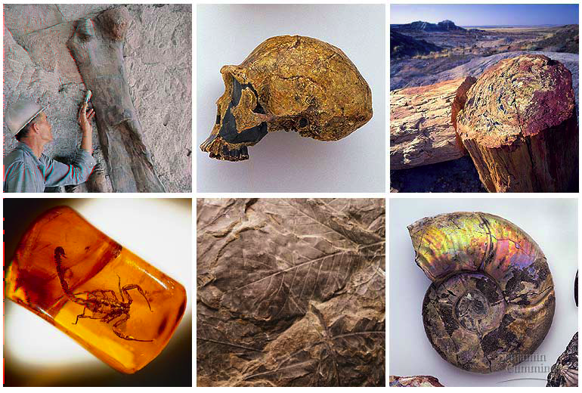
Fossils tell a story…
the Earth is old
Life is old
Life on Earth has changed

Slide 18
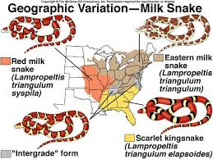
2. Evidences for Evolution: Geographical Distribution of Living Species

Slide 19
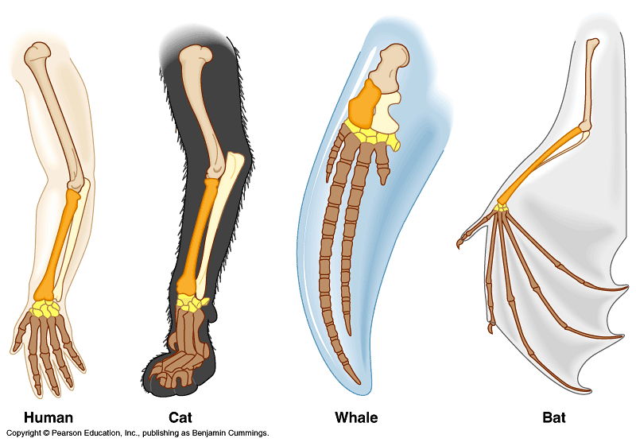
3. Homologous Structures
The same bones under the skin
  limbs that perform different functions are built from the same bones
How could these
very different animals
have the
same bones?

Slide 20
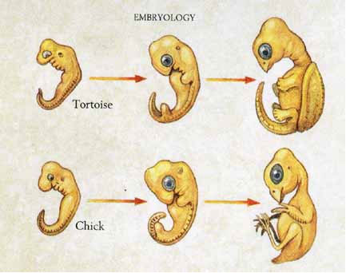
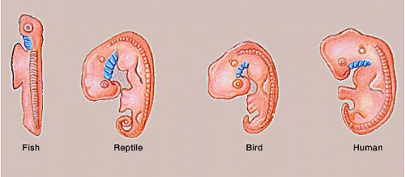
4. Evidence of Evolution: Early Development of Organisms
Development of embryo tells an evolutionary story
  similar structures during development
all vertebrate embryos have a “gill pouch” at one stage of development

Slide 21
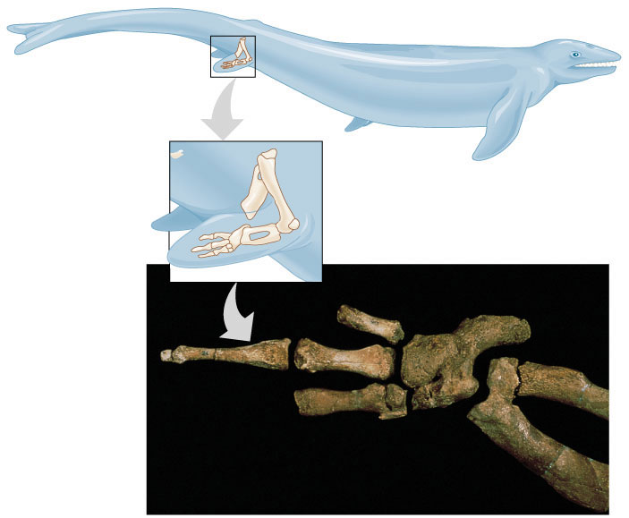
5. Evidence of Evolution: Vestigial organs
Hind leg bones on whale fossils
Why would whales have pelvis & leg bones if they were always sea creatures?
Because they
used to
walk on land!

