Slide 1
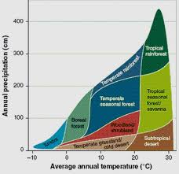
Diagram

Slide 2
Biomes, Marine Ecosystems, and Population Growth
May 10th, 2016

Slide 3
Biomes
Definition: Group of ecosystems that have the same climate and dominant communities

Slide 4
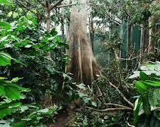
Tropical Rain Forest
Abiotic Factors: hot and wet year-round; thin, nutrient-poor soils

Slide 5
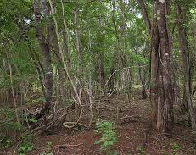
Tropical Dry Forest
Abiotic Factors: generally warm year-round; alternative wet and dry seasons; rich soils subject to erosion

Slide 6
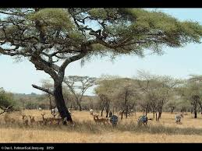
Tropical Savanna
Abiotic Factors: warm temperatures; seasonal rainfall; compact soil; frequent fires set by lightning

Slide 7
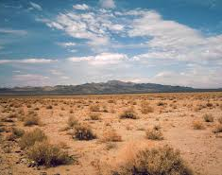
Desert
Abiotic factors: low precipitation; variable temperatures; soils rich in minerals but poor in organic material

Slide 8
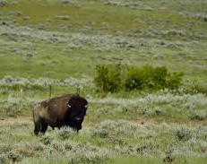
Temperate Grassland
Abiotic Factors: warm to hot summers; cold winters; moderate, seasonal precipitation; fertile soils; occasional fires

Slide 9
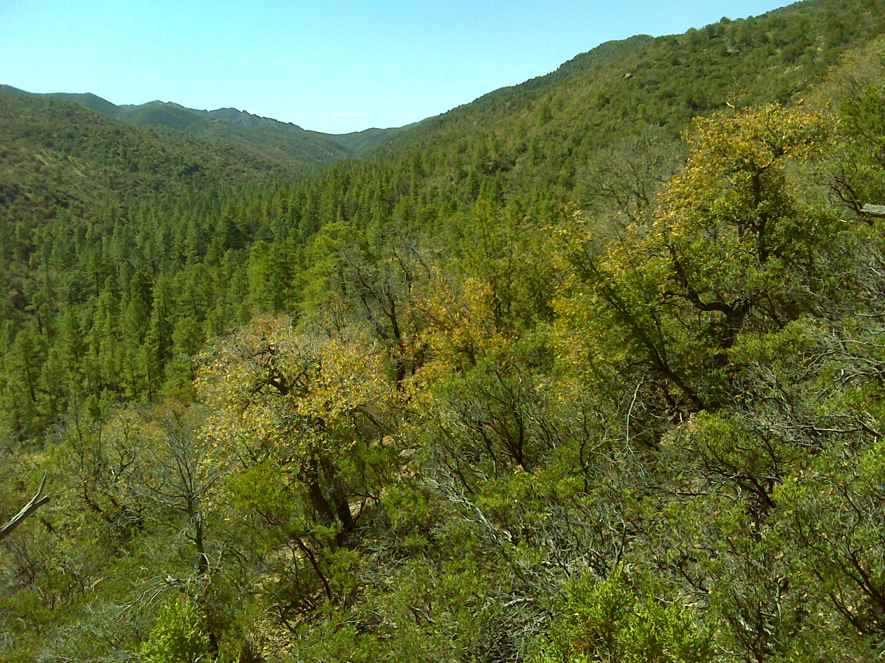
Temperate Woodland and Shrubland
Abiotic factors: hot, dry summers; cool, moist winters; thin, nutrient-poor soils; periodic fires

Slide 10
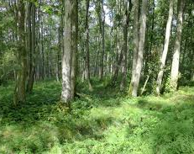
Temperate Forest
Abiotic factors: cold to moderate winters; warm summers; year-round precipitation; fertile soils

Slide 11
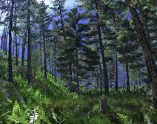
Northwestern Coniferous Forest
Abiotic factors: mild temperatures; abundant precipitation during fall, winter, and spring; relatively cool, dry summer; rocky, acidic soils

Slide 12
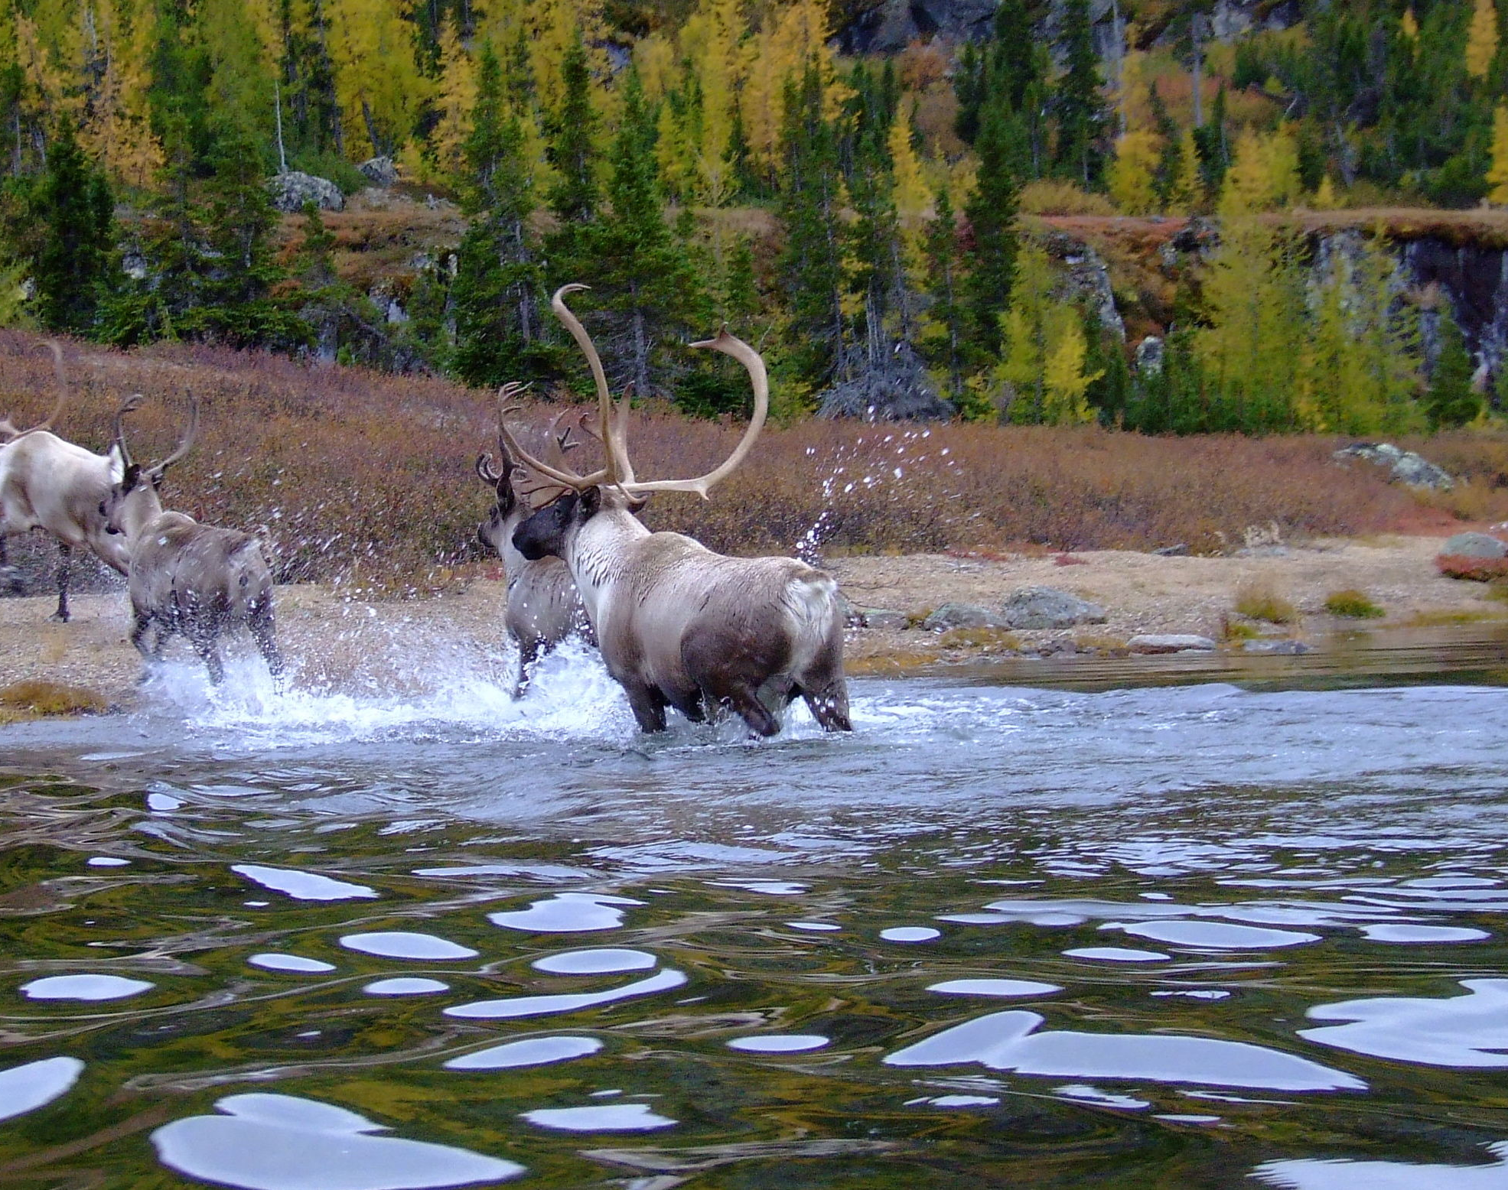
Boreal Forest
Abiotic factors: long, cold winters; short, mild summers; moderate precipitation; high humidity; acidic, nutrient-poor soils

Slide 13
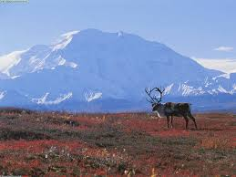
Tundra
Abiotic factors: strong winds; low precipitation; short and soggy summers; long, cold, and dark winters; poorly developed soils; permafrost

Slide 14
Aquatic Ecosystems
Aquatic ecosystems are determined by the depth, flow, temperature, and chemistry of the overlying water
  Freshwater Ecosystems
  Estuaries (wetlands formed where rivers meet the sea)
  Marine Ecosystems

Slide 15
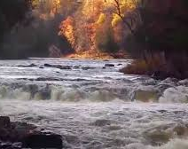
Flow-Water Ecosystems
Rivers and streams
Water is high in oxygen
Organisms must adapt to the fast flow rate

Slide 16
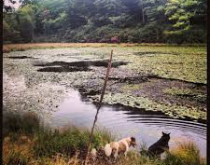
Standing-Water Ecosystems
Lakes and ponds
Still water allows more phytoplankton to survive
High amount of biodiversity

Slide 17
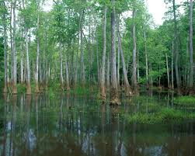
Freshwater Wetlands
Wetland – an ecosystem in which water either covers the soil or is present near the surface of the soil for at least part of the year
Usually very productive
Includes bogs, marshes, and swamps

Slide 18
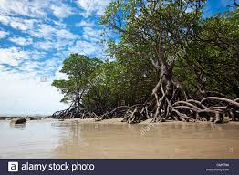
Estuaries
Includes salt marshes and mangrove swamps
Nursery grounds for fishes and shellfish

Slide 19
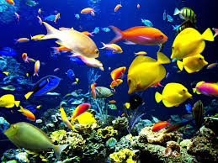
Marine Ecosystems
Photic Zone – well-lit upper layer of oceans where photosynthesis takes place
Aphotic Zone – Permanently dark zone below the photic zone (chemosynthetic autotrophs are the only produces that survive here)

Slide 20
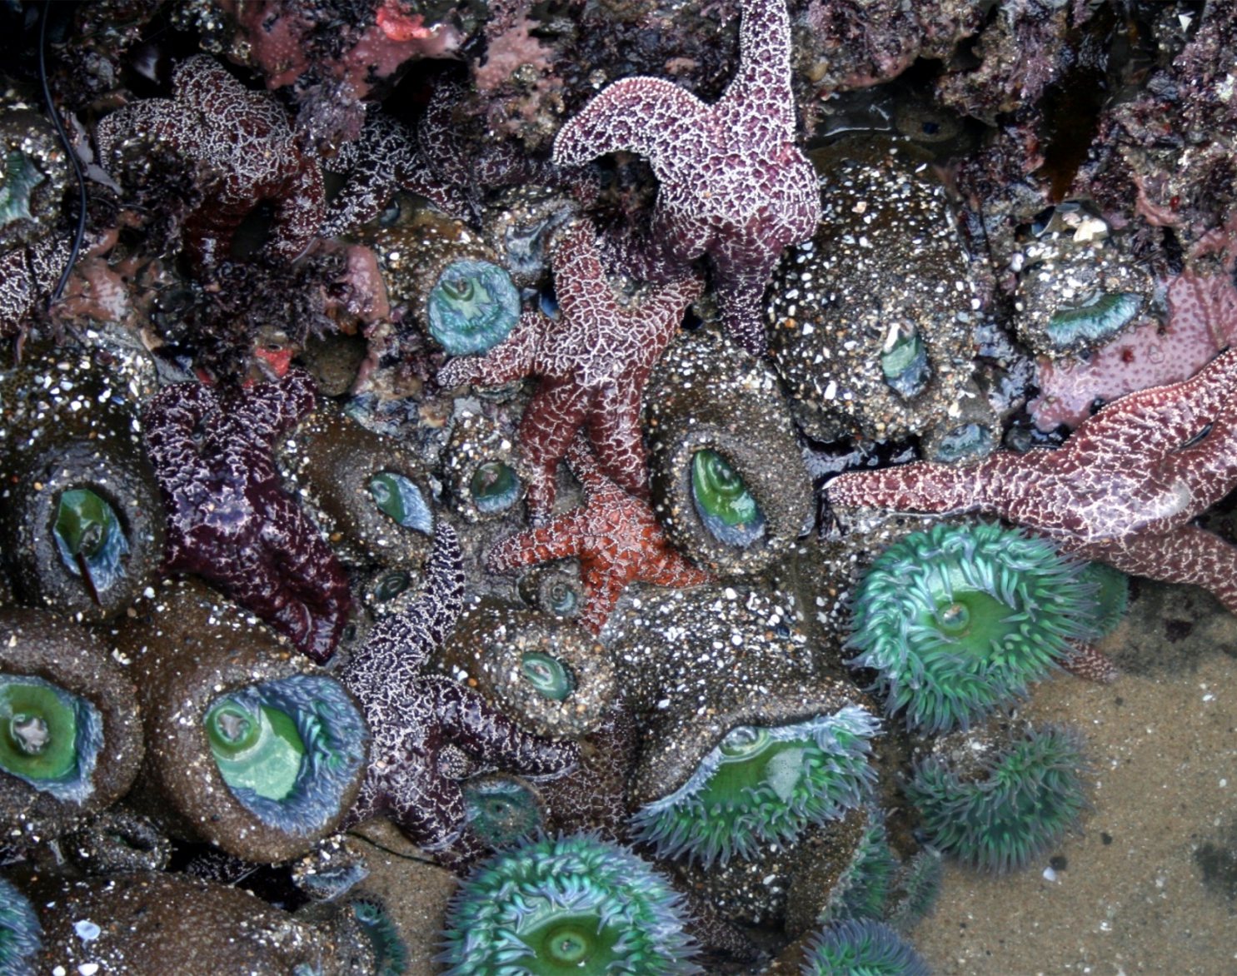
Intertidal Zone
Organisms here experience the force of the tides
Intertidal zones may be submerged by ocean water once or twice a day
Rapid drying and flooding process makes this zone challenging for organisms to live in

Slide 21
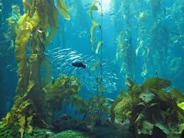
Coastal Ocean
Coastal ocean extends from the low-tide mark to the outer edge of the continental shelf
Includes kelp forests

Slide 22
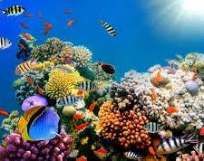
Coral Reefs
Most productive marine zone (has the most phytoplankton)
Found in warm and shallow tropical waters

Slide 23
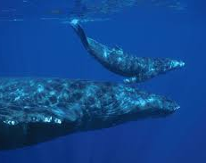
Open Oceans
Largest marine zone
Low levels of nutrients and only a small number of producers

Slide 24
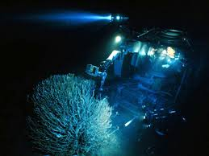
Benthic Zone
Ocean Floor
Aphotic
Organisms must rely upon detritus falling from above or from deep sea vents (chemosynthetic bacteria)

