Slide 1
May 17 – Honors Biology

Slide 2
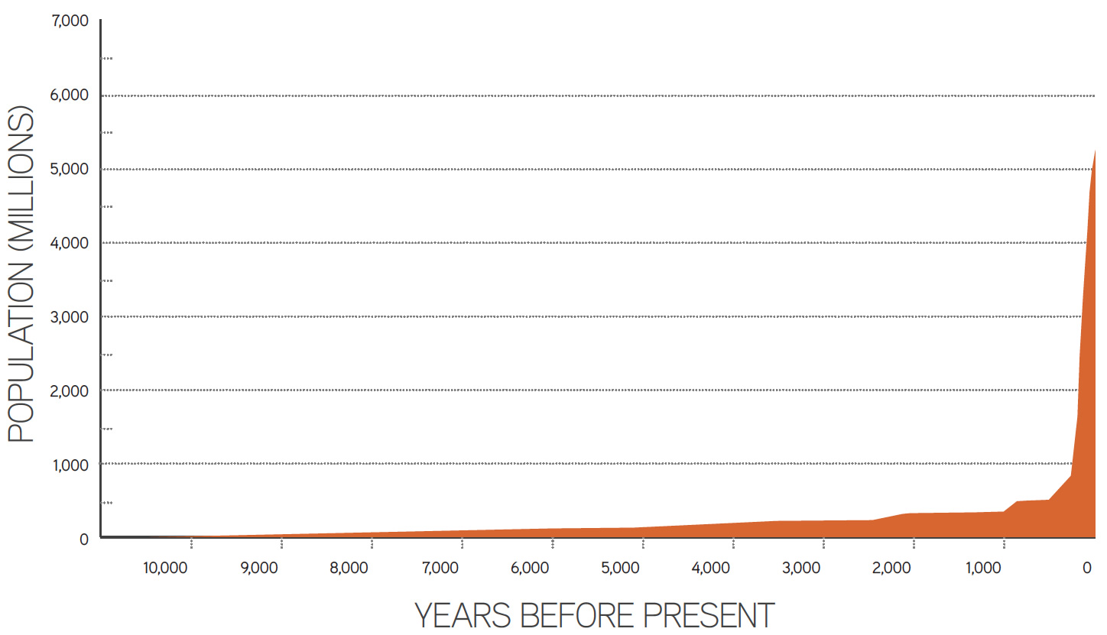

Slide 3
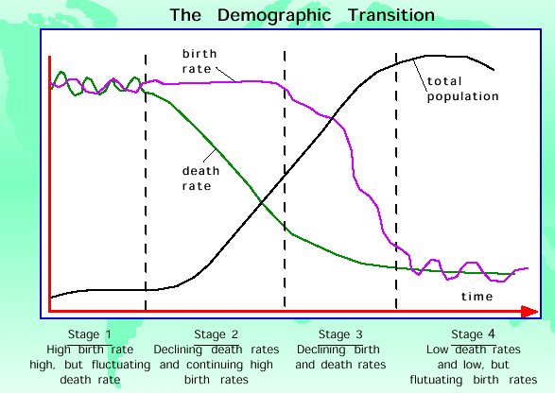

Slide 4
