Slide 1
Pedigree Problems Extra Practice Key

Slide 2
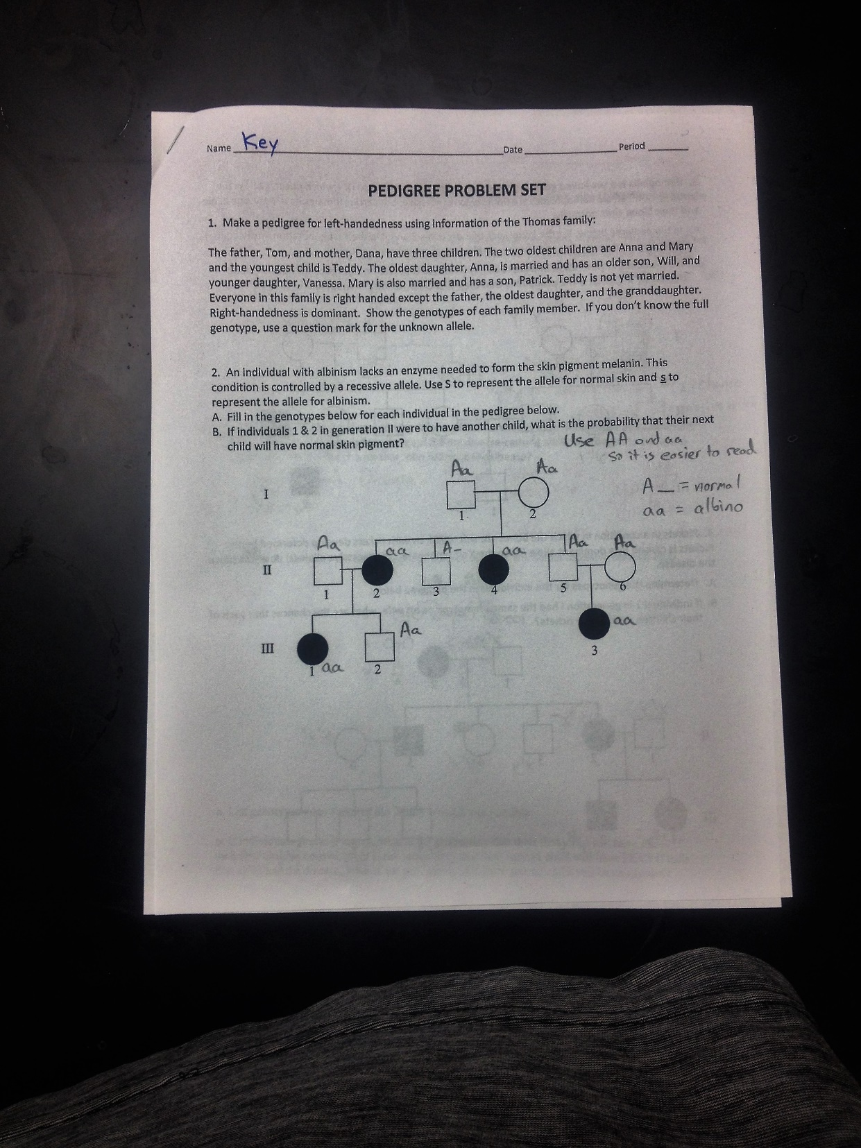

Slide 3
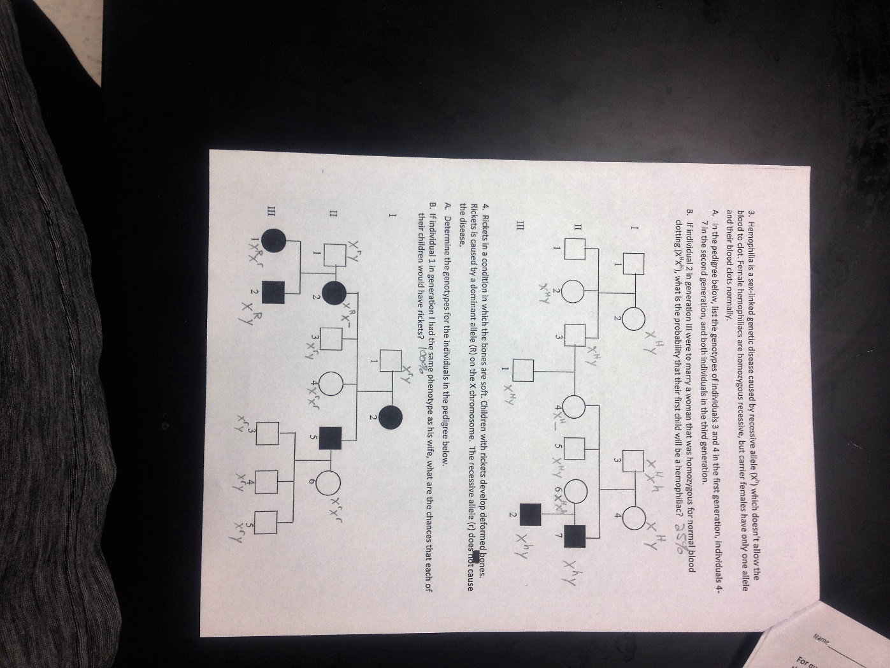

Slide 4
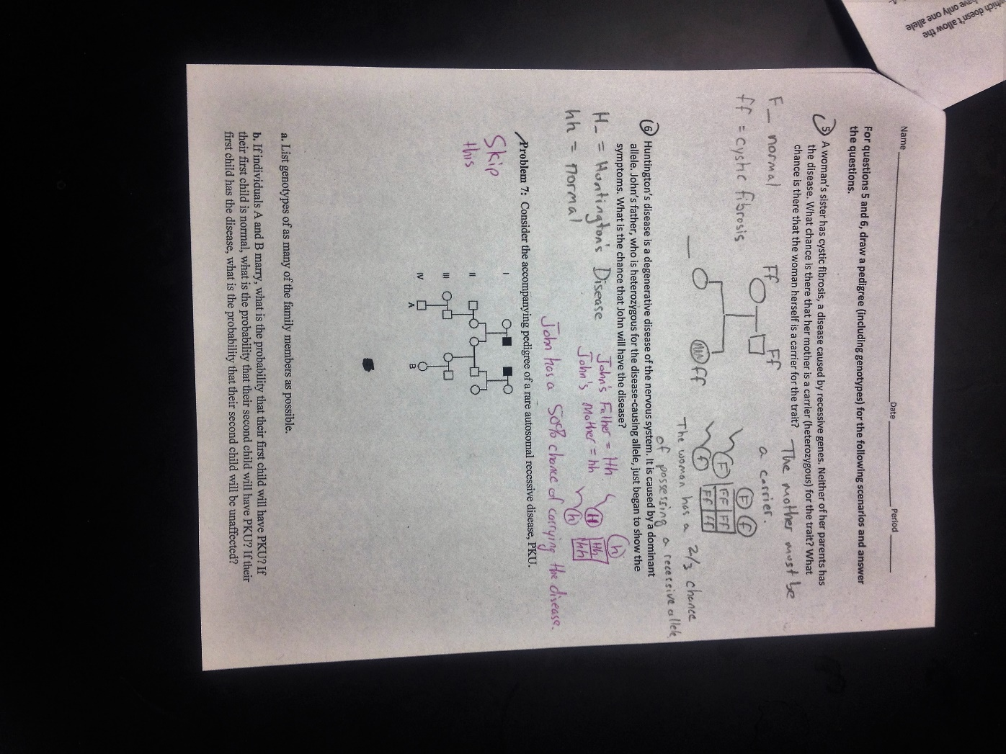

Slide 5
